Slide 1


IBM DATA SCIENCE
CAPSTONE PROJECT
Name: Lim Khai Sian
Date: 06/07/2023

Slide 2
Outline
Executive Summary
Introduction
Methodology
Results
Conclusion
Appendix

Slide 3
Executive Summary
Summary of methodologies
Data Collection
Data Wrangling
Exploratory Analysis
Interactive Visual Analytics
Predictive Analysis
Summary of all results
Exploratory Analysis Result
Visual Analytics
Interactive Dashboard
Predictive Analysis Model

Slide 4
Introduction
Project background and context
Companies are making space travel affordable. SpaceX is sending spacecraft to the International Space Station and sending manned missions to Space. SpaceX can achieve these because the rocket launches are relatively inexpensive due to the reuse of first stage. if we can determine if the first stage will land, we can determine the cost of a launch
Problems to be solved
Whether the rocket launch configurations affect the success rate of first stage landing
Predict whether first stage will land based on the relevant configurations

Slide 5
Methodology

Slide 6
Methodology
Executive Summary
Data Collection Methodology:
SpaceX REST API
Web scraping from Wikipedia
Perform Data Wrangling
Filter data to include only Falcon 9
Handle missing value
Calculate the number of launches on each site
Calculate the number and occurrence of each orbit
Calculate the number and occurrence of mission outcome of the orbits
Convert Landing Outcome to binary format
0 indicate did not land successfully
I indicate did land successfully
Perform Exploratory Data Analysis (EDA)
Use SQL queries to evaluate the dataset
Use Pandas and Seaborn to visualize and evaluate the relationship between different features
Perform interactive visual analytics
Use Folium to visualize the geospatial information such as launch sites and success/failed launched for each site
Create an interactive dashboard using Plotly Dash to visualize the relationship between launch sites and payload mass
Perform predictive analysis
Standardize the data
Split data between train and test sets
Train different algorithm:
Logistic Regression
Support Vector Machine
Decision Tree
K Nearest Neighbors
Use Grid Search to find best parameters
Use Confusion Matrix to evaluate models

Slide 7
Data Collection – SpaceX API
Make a get request to the SpaceX API to obtain data about launches including, information about
rocket used, payload delivered, launch specifications, landing specifications, and landing outcome.
Step 1
Request and parse the SpaceX launch data using GET request
Decode response content as a Json and turn it into a Pandas DataFrame
Step 2
Use custom logic to clean the data
Create lists for data to be stored
Step 3
Use pre-defined functions and relevant SpaceX API to get information about the launches using the IDs given for each launch from the DataFrame in Step 1
Step 4
Convert the lists into a dictionary then convert to Pandas DataFrame again
Filter DataFrame to only include Falcon 9 launches
Reset the FlightNumber column
Step 5
Replace np.nan values with mean in the PayloadMass column

Slide 8
Data Collection – Web Scraping
Use the Python BeautifulSoup package to web scrape some HTML tables from Wikipedia that
Contain valuable Falcon 9 launch records
Step 1:
Perform HTTP GET method to request the Falcon 9 Launch HTML page
Create a BeautifulSoup object from the HTML response
Step 2:
Find all tables in the wiki page
Extract target table
Use pre-defined function to extract column names from the table header
Step 3:
Create an empty dictionary using the column names
Use custom logic and pre-defined functions to extract data from the tables to fill in the dictionary
Step 4:
Convert the dictionary into a Pandas DataFrame

Slide 9
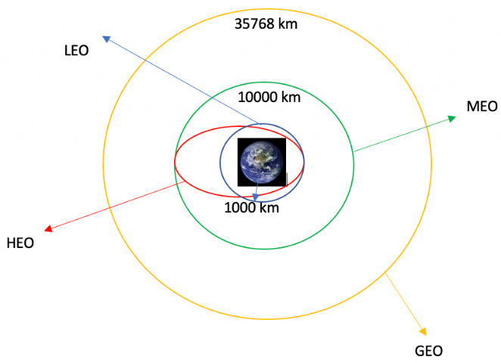
Data Wrangling
Table Attributes:
“LaunchSite” column contains the different launch site name
“Orbit” column contains the dedicated orbit each launch aims to
“Outcome” column indicate if the first stage successfully landed
Data Wrangling
Calculate the number of launches on each site
Calculate the number and occurrence of each orbit
Calculate the number and occurrence of mission outcome of thw orbit

Slide 10
Data Wrangling
8 different values in “Outcome” column
True Ocean: successfully landed on a specific region of the ocean
False Ocean: unsuccessfully landed to a specific region of the ocean
True RTLS: successfully landed to a ground pad
False RTLS: unsuccessfully landed to a ground pad
True ASDS: successfully landed to a drone ship
False ASDS: unsuccessfully landed to a drone ship
None ASDS: failure to land
None None: failure to land
Data Wrangling
Define bad_outcome set in the Outcome column
Create a landing_class list where the element is zero if the Outcome value in that row is in the bad_outcome set else the element is one
Zero indicate first stage did not land successfully
One indicate first stage landed successfully
Assign the landing_class list as a new column in the dataset

Slide 11
EDA with Data Visualization
Scatter Plot
Visualize the relationship between:
Flight Number and PayloadMass
Flight Number and Launch Site
PayloadMass and Launch Site
Flight Number and Orbit type
PayloadMass and Orbit type
Scatter Plot is used to visualize the relationship between two variables
Bar Plot
Visualize the relationship between:
Success rate of each orbit type
Bar Plot is used to visualize categorical variable against numerical values
Line Plot
Visualize the relationship between:
Year and success rate
Line Plot is used to visualize the trend of a variables

Slide 12
EDA with SQL
Use SQL queries to gather information from the dataset
Display the names of the unique launch sites in the space mission
Display 5 records where launch sites begin with the string “CCA”
Display the total payload mass carries by booster launched by NASA (CRS)
Display average payload mass carries by booster version F9 v1.1
List the date when the first successful landing outcome in ground pad was achieved
List the names of the boosters which have success in drone ship and have payload mass greater than 4000 but less than 6000
List the total number of successful and failure mission outcomes
List the names of the booster_versions which have carries the maximum payload mass
List the records which display the month names, failure landing_outcomes in drone ship, booster versions, launch_site for the months in year 2015
Rank the count of landing outcomes or success between date 2010-06-04 and 2017-03-20

Slide 13
Interactive Map with Folium
Mark all launch sites on map
Create an initial map using the Map object in Folium
Add circle and marker objects for each launch sites to the map
Mark the success/failed launches for each site on the map
Create a cluster object to group launches with the same coordinate
Mark successful launches as green and failed launches as red
Create a marker for each launch with the color label
Add each marker to the cluster object
Add the cluster to the map object
Calculate the distances between launch site to its proximities
Calculate the distance between a launch site to the closest coastline, railway, highway, city
Create a marker object for each locations using the coordinate
Draw a line between the launch site and all locations using the PolyLine object

Slide 14
Interactive dashboard with Plotly Dash
Pie Chart
Display the success rate of launch for each sites
Pie chart can be filtered using the drop-down bar to select different launch sites
Scatter Plot
Display the relationship between Payload mass and outcome with booster version display as different colors
Scatter plot can be filtered using the drop-down bar to select different launch sites and range slider to select different payload range

Slide 15
Predictive Analysis (Classification)
Model Development
Prepare data for model development
Load dataset
Convert Class column to NumPy array
Standardize the features
Split the dataset into train and test set
Training Model
Create GridSearch object and a dictionary of parameters
Parse Model into the GridSearch object
Train the model with train dataset
Model Evaluation
Check the best parameters for each model
Calculate the accuracy score on the train and test dataset
Plot the Confusion Matrix
Model Selection
Create a DataFrame to compare accuracy score for each model
Plot bar chart for train and test dataset accuracy
Select the model with the highest accuracy

Slide 16
Results

Slide 17
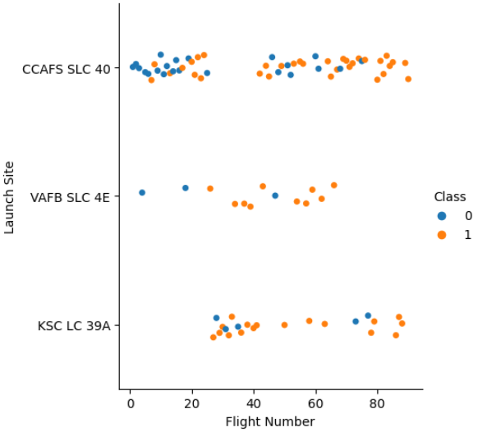
Flight Number vs Launch Site
Most of the initial launches located in CCAFS SLC 40 and are generally failed
Flight number between 20 and 45 are more focus on launch site KSC LC39A
As the flight number increase, the success rate of a launch at the launch site also increase

Slide 18
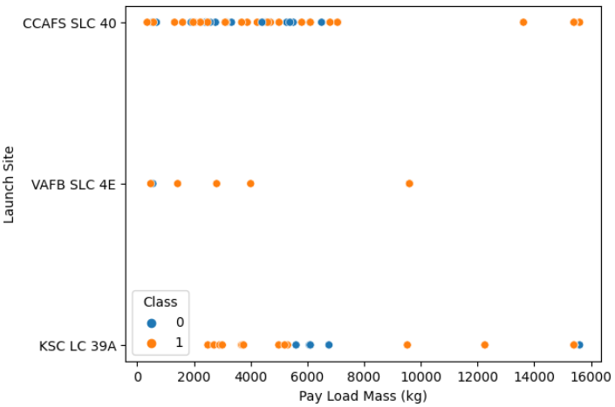
Payload vs Launch Site
Majority of the launches are less than 10000KG
VAFB SLC 4E does not have launches with high payload mass (>10000KG)
Only launches with high payload mass at KSC LC 39A failed
There is not clear relationship between payload and success rate at a launch site

Slide 19
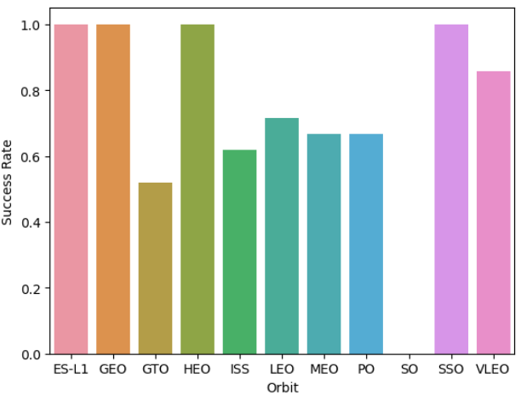
Success Rate vs Orbit Type
There are 4 orbit type with 100% success rate which are ES-L1, GEO, HEO, SSO
The orbit type with lowest success rate is SO

Slide 20
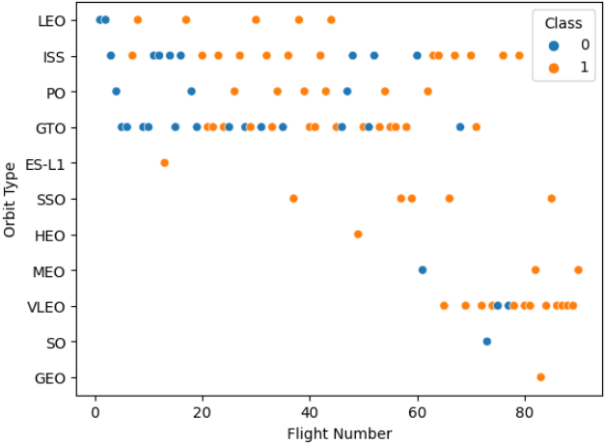
Flight Number vs Orbit Type
There are 3 orbit type which are launched to after flight number 60 which are VLEO, SO, GEO
Most of the launches failed in early stage (flight number < 30) regardless of the orbit type
The orbit type with 100% success rate may due to low sample size
Flight number more than 60 are more focus on orbit type VLEO
There is no clear relationship between flight number and orbit type for GTO

Slide 21
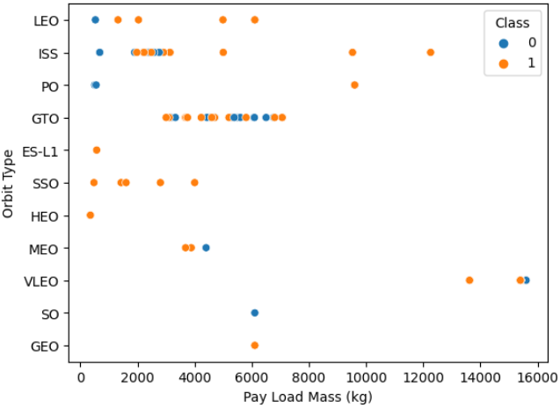
Payload vs Orbit Type
Launches with high payload mass (>10000KG) are fly to orbit type ISS, and VLEO
All launches of VLEO are high payload mass (>10000KG)
There is no clear relationship between payload and orbit type for GTO

Slide 22
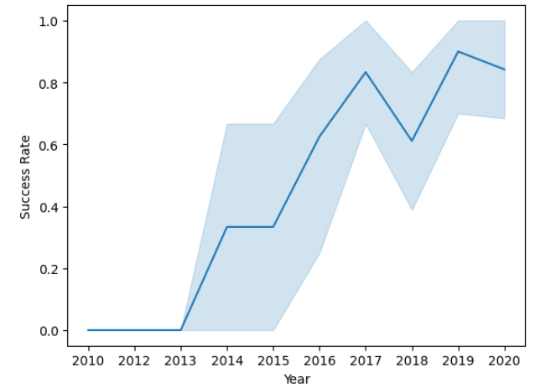
Launch Success Yearly Trend
The success rate only increase after year 2013
There is no improvement in success rate between year 2014 and 2015
There is a significant increase in success rate between year 2015 and 2017
There is a drop in success rate between year 2017 and 2018
The success rate generally shows an increasing trend

Slide 23

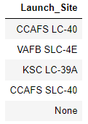
All Launch Site Names
The DISTINCT keyword is used to get the unique value in the “Launch_Site” column
There are 4 specified launch sites in this dataset
There are launches in the dataset without clear launch site

Slide 24

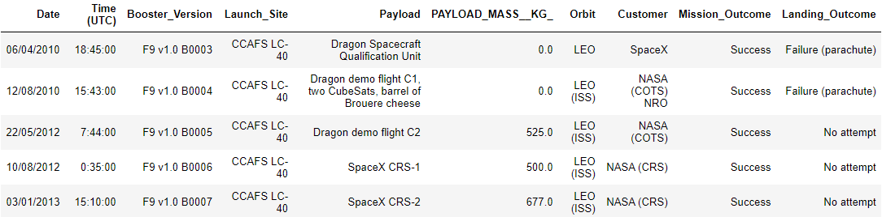
Launch Site Names Begin with “CCA”
The LIKE keyword is used to find the value that start with “CCA” in the “Launch_Site” column
The LIMIT keyword is used to limit the number of record returned
All the result from this query are success
4 of the customer of the result are NASA and 1 is SpaceX

Slide 25


Total Payload Mass
The SUM keyword is used to sum up the value returned
The WHERE clause is used to filter customer from “NASA (CRS)”
The total payload mass from customer NASA (CRS) is 45596KG

Slide 26


Average Payload Mass by F9 v1.1
The AVG keyword is used to find the average of the value returned
The WHERE clause is used to filter booster version F9 v1.1
The average payload mass of booster version F9 v1.1 is 2928.4KG

Slide 27


First Successful Ground Landing Date
The MIN keyword is used to find the minimum among the value returned
The LIKE keyword is used to find the value that have “success” and “ground pad” in the “Landing_Outcome” column
The first successful landing in ground pad was achieved at 01/08/2018

Slide 28
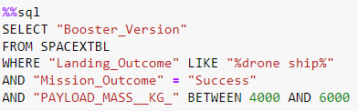
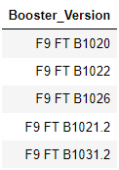
Successful Drone Ship Landing with Payload between 4000 and 6000
The LIKE keyword is used to find value that have “drone ship” in the “Landing_Outcome” column
The WHERE clause is used to filter success mission outcome
The WHERE clause is also used to filter payload mass between 4000 and 6000
There are 5 successful launches in drone ship with payload mass between 4000 and 6000

Slide 29

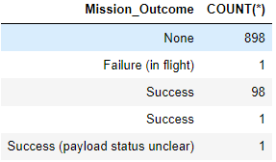
Total Number of Successful and Failure Mission Outcomes
The COUNT keyword is used to calculate the total number of records returned
The GROUP BY keyword is used to ground the result by the values in “Mission_Outcome” column

Slide 30

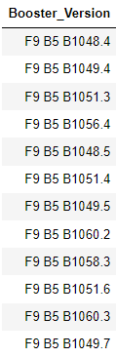
Booster Carries Maximum Payload
The DISTINCT keyword is used to find the unique value in the “Booster_Version” column
The WHERE clause is use to find the maximum value in the “PAYLOAD_MASS_KG_” column
There are 12 booster versions with the maximum payload mass

Slide 31


2015 Launch Records
The SUBSTR keyword is used to get the month from the date
The WHERE clause is used to extract data in year 2015
The LIKE keyword is used to find value that have “failure” and “drone ship” in the “Landing_Outcome” column
There is only 2 failure launches on drone ship in year 2015
Both launches are at launch site CCAFS LC-40

Slide 32
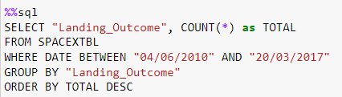
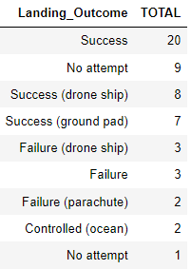
Rank Landing Outcomes Between 2010-06-04 and 2017-03-20
The COUNT keyword is used to calculate the total number of records returned
The WHERE clause is used to get the data between 2010-06-04 and 2017-03-20
The GROUP BY keyword is used to group the result by the values in “Landing_Outcome” column
The ORDER BY keyword is used to order the result by the total number of records in descending order
There are 20 success launches between this period
There are 10 launch with no attempt to land the first stage

Slide 33
Launch Sites Proximities Analysis

Slide 34
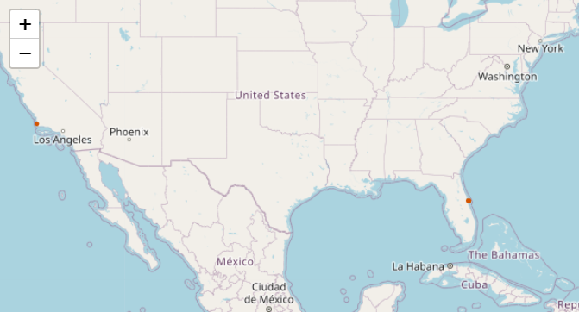
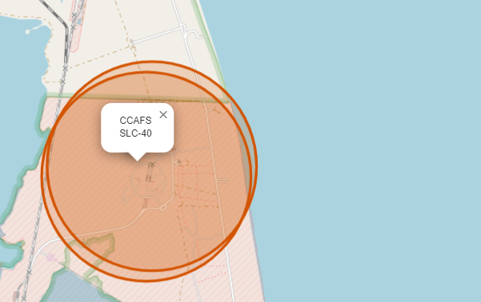
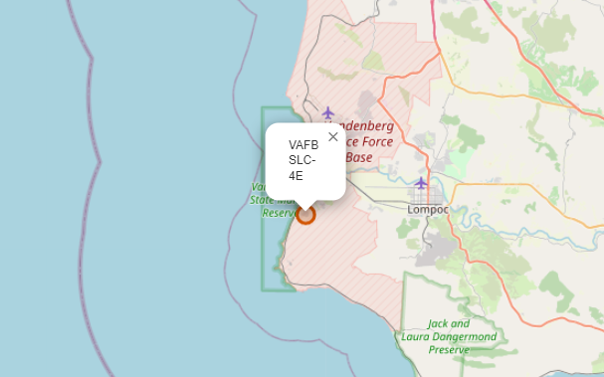
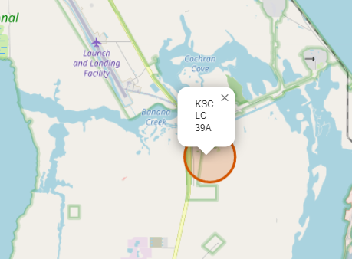
All Launch Sites on a map
All the launch sites are on the coast of the USA
CCAFS LC-40 and CCAFS SLC-40 launch sites are overlapped

Slide 35
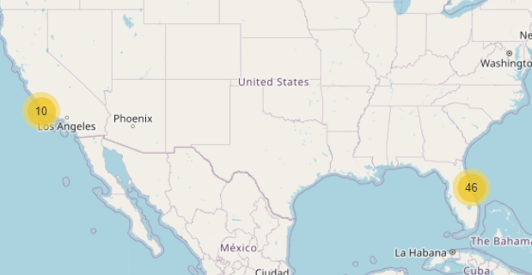
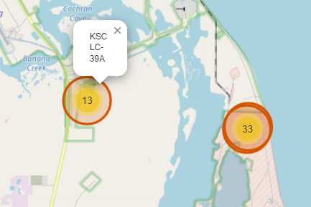
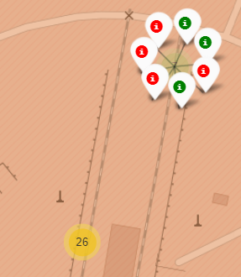
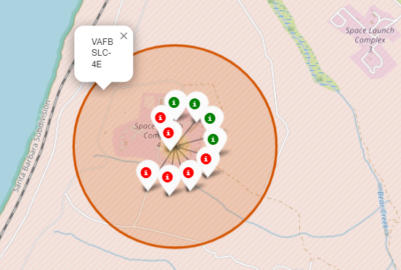
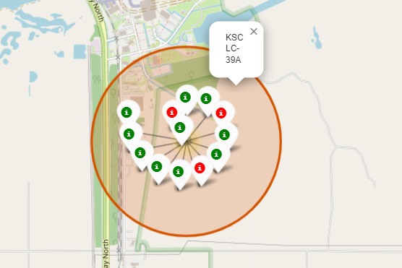
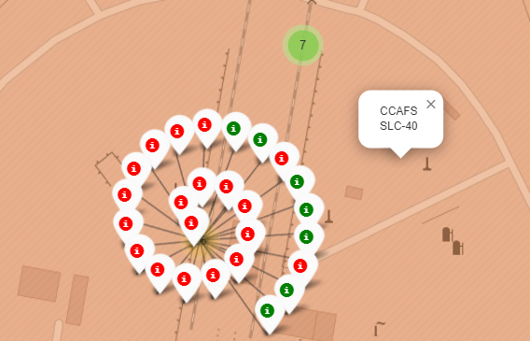
All success/failed launches for each site on the map
The green markers indicate success launches and red markers indicate failed launches
There is only 10 launches in VAFB SLC-4E which located in Los Angeles
The KSC LC-39A has the most successful launches

Slide 36
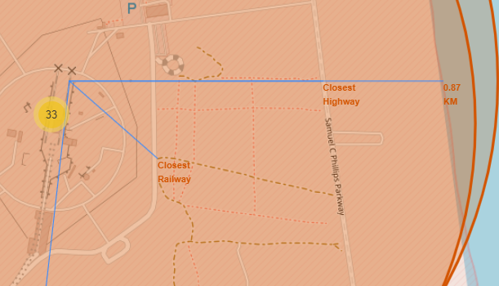
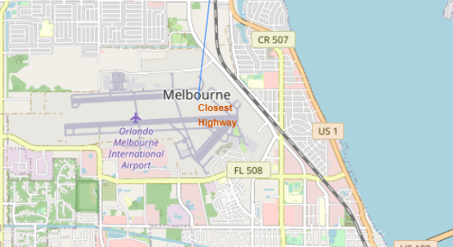
Proximities of launch site to point of interest
The launch site is in close proximity to the railway
The launch site is in close proximity to highway
The launch site is in close proximity to coastline
The launch site keep certain distance away from cities

Slide 37
Interactive Dashboard with Plotly Dash

Slide 38
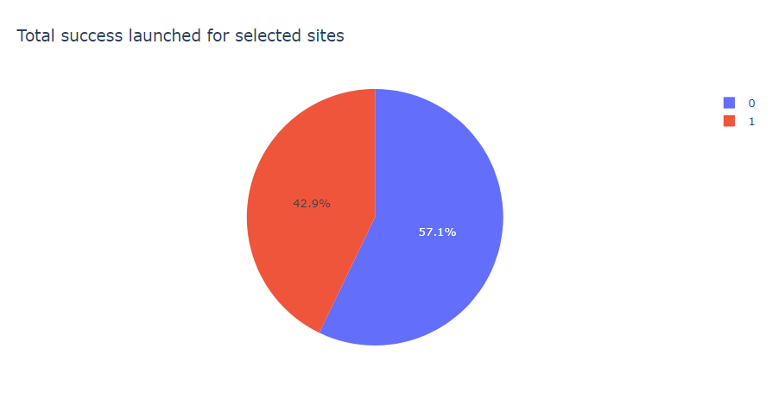
Launch success count for all sites
The total success rate for all launch sites is only 42.9%

Slide 39
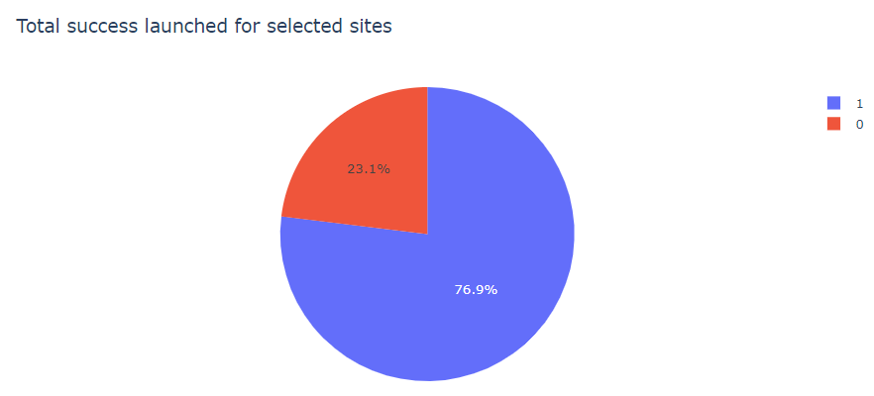
Launch site with the highest launch success ratio
The KSC LC-39A launch site has the highest success ratio of 76.9%

Slide 40
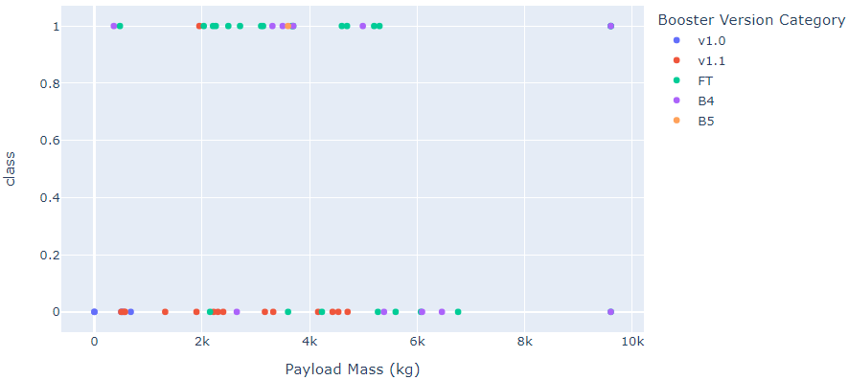
Payload vs Launch Outcome scatter plot for all sites
There is only 2 launches with payload greater than 8000KG and both are B4 booster version
The FT booster version has higher success rate
Most of the launch of v1.1 booster version failed

Slide 41
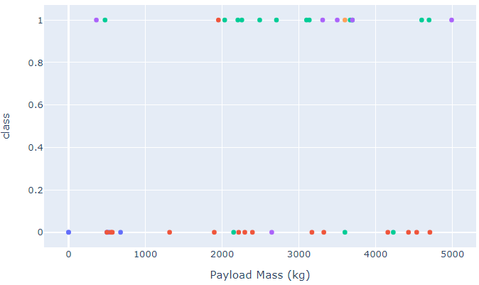
Payload vs Launch Outcome scatter plot for all sites
Most of the launches for payload mass smaller than 5000KG are FT and v1.1 booster version

Slide 42
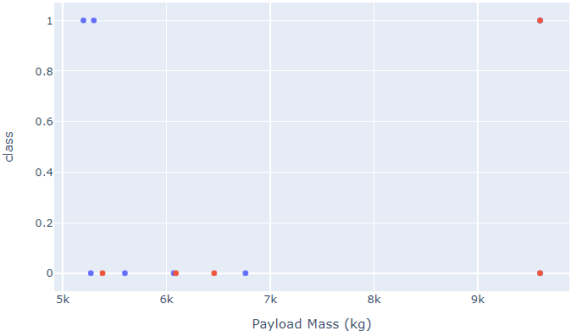
Payload vs Launch Outcome scatter plot for all sites
The is only FT and B4 booster version for payload mass greater than 5000KG
The success rate of launches with payload mass greater than 500KG is are low

Slide 43
Predictive Analysis (Classification)

Slide 44
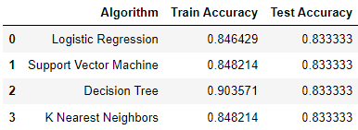
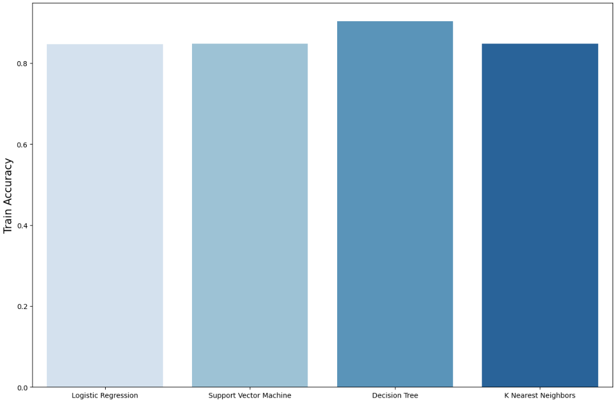
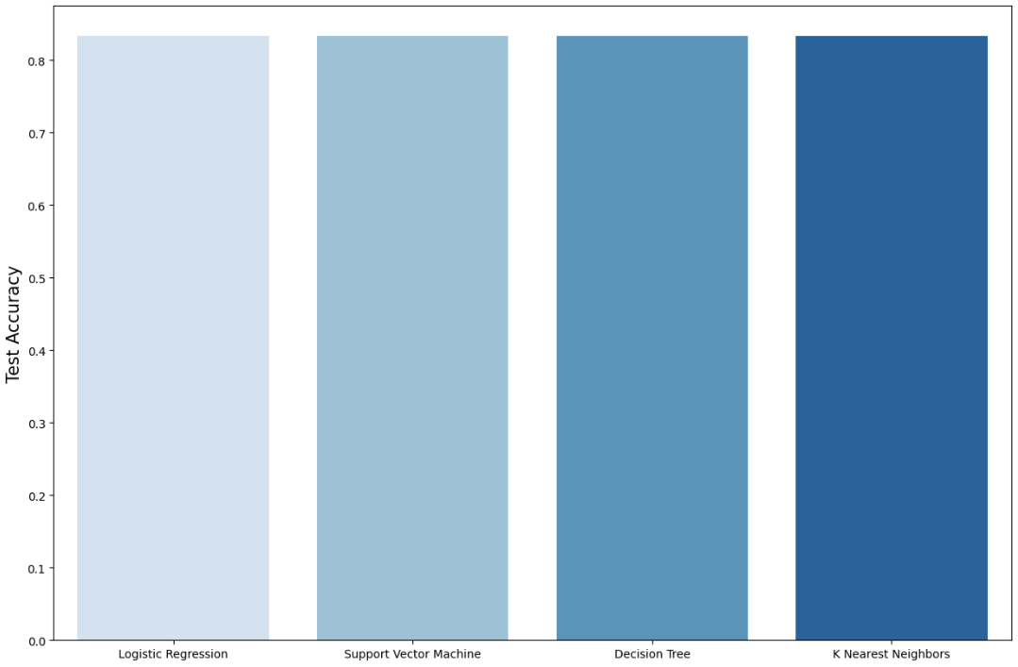
Classification Accuracy
The test accuracy are the same among all algorithms
Decision Tree has the highest Train accuracy among all algorithms which is 90.35% Train accuracy and 83.33% Test accuracy

Slide 45
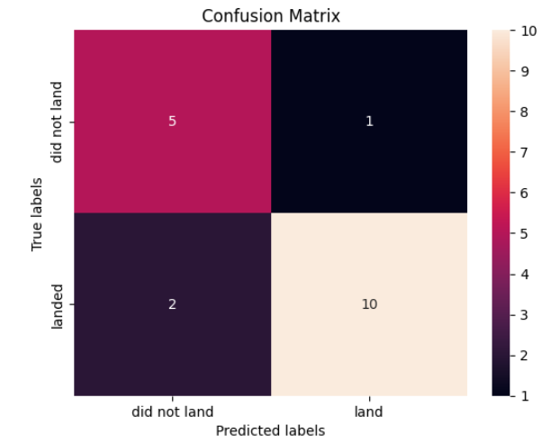
Confusion Matrix
The model is able to predict 10 out of 12 successful outcome correctly
The model is able to predict 5 out of 6 failed outcome
The precision score is 90.9% (10/11)
The recall score is 83.33% (10/12)

Slide 46
Conclusions

Slide 47
Conclusions
As the number of flight increases, the rate of success also increase
There is no success launches between 2010 and 2013
The success rate increase gradually starting in 2013 until 2017 before a drop in success rate
Starting from 2013 the success rate is greater than 60%
Orbit types ES-L1, GEO, HEO, SSO has 100% success rate
The 100% success rate can be dues to insufficient sample size
All launches of VLEO are high payload mass (>10000KG)
The KSC LC-39 A launch site has the highest success rate of 76.9%
The success rate of payload mass greater than 5000KG is lower than launches with lower payload mas (lesser than 5000KG)
The classification model with the best accuracy is Decision Tree of 90.35%

